Slide 1



AI Master Class series – Day 23
Evaluating & Deploying Machine Learning Algorithm

Slide 2
Workflow of ML application design.
Loading Dataset
Visualizing Dataset
Initializing ML algorithm
Dataset Splitting as Train & Val
Train & Evaluate
Save Model
Deploy Trained Model

Slide 3
Load & Summarize Dataset
LOADING DATASET
from pandas import read_csv
fileName = “fileName.csv"
dataset = read_csv(fileName, names)
SUMMARIZE DATASET
dataset.shape #Size of Dataset rows & Columns
dataset.head(20) #Top 20 Values in Dataset
dataset.describe() #Info about Dataset
dataset.groupby('class').size() #returns Number of data for each class

Slide 4
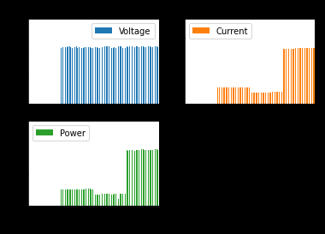
Visualizing Dataset
PANDAS & MATPLOTLIB
from pandas.plotting import scatter_matrix
from matplotlib import pyplot
dataset.plot(kind='bar',subplots=True,layout=(2,2))
pyplot.title('BAR PLOT')
pyplot.show()

Slide 5
Importing & Training Algorithm
from sklearn.svm import SVC
Model = []
models.append(('SVM', SVC(gamma='auto')))
model.fit(X_train, Y_train)

Slide 6

! PRACTICAL SESSION !

Slide 7
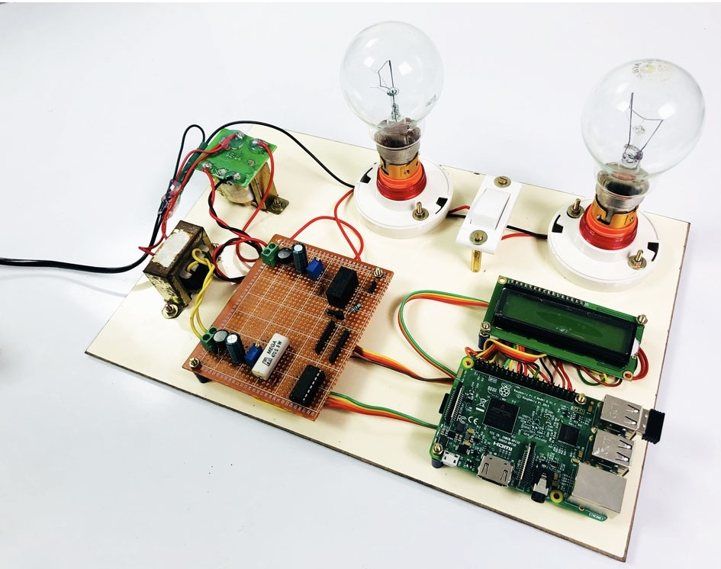
Dataset
Note: You can use ur dataset

Slide 8
Evaluating ML Algorithm for identifying Power Consumption in Energy Meter Reading

Slide 9
Deploying application in certain algorithm which has more accuracy

Slide 10
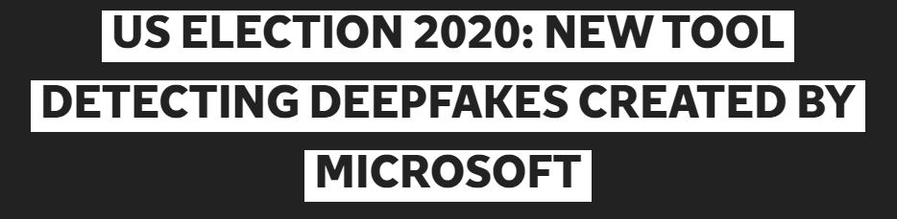
AI News – Day 22. SEPT - 2020
Microsoft has announced a new tool that it has developed in order to combat the spread of deepfakes, ahead of the US presidential election in November.
A “deepfake” is a video where artificial intelligence and deep learning – an algorithmic learning method used to train computers – has been used to make a person appear to say something they have not.

Slide 11
Thanks!
Tomorrow session
Fake News detection using ML

Slide 12
Day-22 Agenda.
01.
02.
03.
Workflow
Basic Syntax
Deploying ML
Workflow of ML Application
ML application design basic syntax
Energy Meter Power consumption detection using ML

